Slide 1
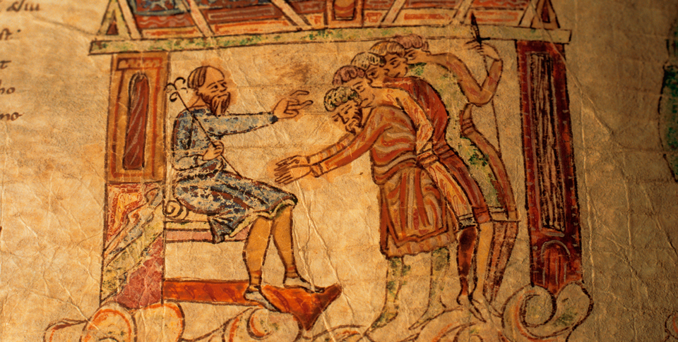
Medieval Christian Europe (330–1450)
Topic 1 Lesson 5 The Feudal Monarchs and the Church

Slide 2
Medieval Christian Europe (330–1450)
Topic 1 Lesson 5 The Feudal Monarchs and the Church
Learning Objectives
Learn how monarchs gained power over nobles and the Christian Church, and how English kings strengthened their power.
Describe how traditions of government evolved under King John and later English monarchs.
Explain how strong monarchs unified France.
Describe the formation of the Holy Roman Empire and how some emperors struggled with the papacy to control specific religious and secular issues.
Analyze how the Church reached the height of its power under Pope Innocent III.

Slide 3
Feudal Monarchs Begin to Centralize Power
From 1000 to 1300 the balance of power is going to shift from nobles and the church to the monarchs
They are going to strengthen the royal courts, crushing the power of the courts of nobles and clergy
They are going to set up bureaucracies in order to collect taxes and administer justice
This will allow them to have standing armies instead of relying on nobles
The middle class will turn to the monarchs to keep the peace which promotes business

Slide 4
Feudal Monarchs Begin to Centralize Power
This image from an 11th-century Bible shows a king receiving fealty from his nobles.

Slide 5
English Kings Expand Their Power
The Norman Conquest of England
In 1066 Edward, King of England, dies w/o an heir
English nobles choose Harold, Edward’s brother in law, to be king
William, the Duke of Normandy also claims the throne. He is Edward’s cousin
At the Battle of Hasting he becomes William the Conqueror and is crowned king on Christmas day 1066
William Exerts Firm Control
Is going to give lands to the Church and his Norman barons who fought with him but is going to keep a large portion
He is going to demand fealty (loyalty) first before others
Is going to complete a census called the Domesday Book which lists every castle, field, and pigpen in England
Blending of Norman French and Anglo Saxons customs, languages, and traditions

Slide 6
English Kings Expand Their Power
Extending Royal Power
William’s successor’s are going to create the exchequer
Collects fines, taxes, fees, and other dues
In 1154 Henry II inherits and broadens the system of royal justice
He converted old custom into laws, had traveling justices enforce the laws, and this became the basis for common law
In time people are going to the royal courts instead of the Church’s courts and the courts are going to generate revenue
The Early Jury System
When the traveling justices visited a town they would gather a jury and that group decided which cases should go to trial. This is the ancestor of the Grand Jury
Later another jury of 12 neighbors of an accused person were used in a trial. This is the start of a trial jury

Slide 7
English Kings Expand Their Power
A Tragic Conflict with the Church
Henry II claimed the right to try clergy (priests) in royal courts
Thomas Becket, the archbishop of Canterbury, fiercely opposed this idea
They argue for years about this until Henry says “Who will rid me of this meddlesome priest”
4 knights go to Becket and kill him in his cathedral
Henry is going to deny involvement but is going to back off trying to regulate the clergy
Becket is raised to sainthood and pilgrims go to his tomb and claim miracles happen there.

Slide 8
Developing New Traditions of Government
King John Battles Powerful Enemies
Son of Henry II
In 1205 he loses a war to Phillip II of France and gives up the lands he owns in France
Tries to name the new Archbishop of Canterbury over the Pope’s nominee.
The Pope Innocent III is angered, excommunicates John, and places England under an interdict
John will ask forgiveness and have to pay a fine every year
The Magna Carta
In 1215 a group of nobles will force John to sign the Magna Carta
It will affirm rights for nobles, townspeople, and the Church
It will also make it where the King must follow the law
The due process clause will come from here which gives legal rights to the individual
The idea of habeas corpus, can’t be arrested unless charged with a crime comes from here

Slide 9
Developing New Traditions of Government
Parliament Develops
Originally called the Great Council
1295 King Edward I calls Parliament to approve money to finance his war. He is going to include the “common folk”
This will be the precursor to the two house system, the House of Lords and the House of Commons
Parliament is going to get the power of the purse, the right to approve any new taxes. This is going to provide a check to the monarch’s power

Slide 10
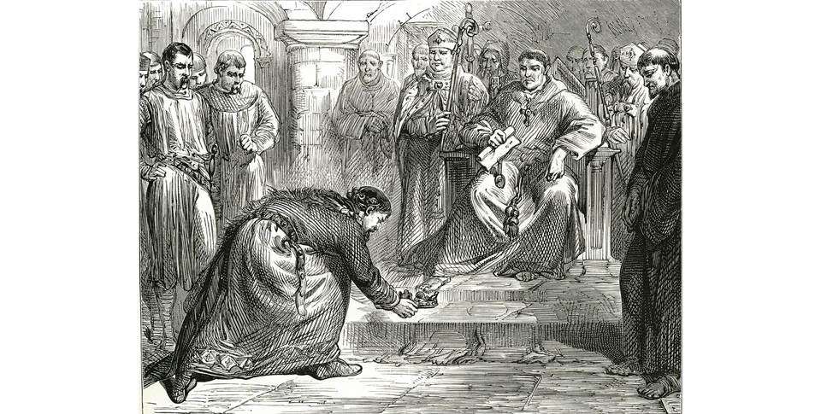
Developing New Traditions of Government
In this illustration from the 1800s, King John lays a token of his submission before the feet of Pope Innocent III's representative, conceding defeat.

Slide 11
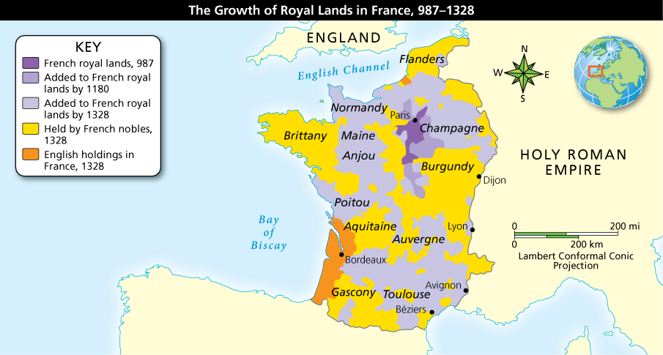
Growth of the French Monarchy
Capetian kings gradually extended royal control over more than half of France.Analyze Maps What overall trend in French royal power does the map show? Where and by whom might that power be challenged after 1328? Explain your answer.

Slide 12
Growth of the French Monarchy
France Under the Capetians
French nobles choose Hugo Capet to become king of France because they thought him weak.
He is going to make the throne hereditary
His heirs are going to play rivals against each other to gain their lands
They are going to gain the support of the Church
Philip Augustus Increases Power and Prosperity
In 1179 Phillip II is going to become King of France
He is going to give jobs to middle class officials the jobs that the nobles used to have to gain loyalty
He is going to quadruple Royal lands by any means
Under the Pope’s request he is going to send knights down to the south of France to suppress a heresy and take over those lands as well

Slide 13
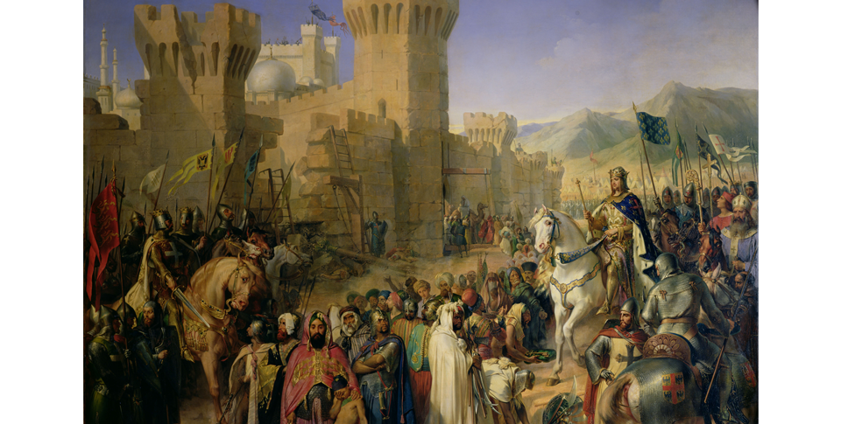
Growth of the French Monarchy
King Phillip II of France meets with townspeople outside of a castle town.

Slide 14
Growth of the French Monarchy
Louis IX: A Model Monarch
Deeply religious, going to set lead 2 wars against the Muslims, persecute heretics and Jews
Expand the Royal Court, outlaw private wars, and end serfdom in his lands.
His prestige will create a strong national feeling for the French people
When he dies France will be emerging as an efficient centralized monarchy and he will become a saint 30 years after his death
Conflicts with the Pope
Louis’s grandson Phillip IV tries to tax the clergy but Pope Boniface VIII rejects him
Phillip sends troops to capture the Pope. He escapes but dies shortly after
A French Pope is elected and moves the court to South of France. An Italian Pope is going to be elected in Rome and claim to be the real Pope

Slide 15
Growth of the French Monarchy
The King Sets Up the Estates General
Set up in 1302, this body of government will have members of all 3 social classes (nobles, clergy, townspeople)
French kings will consult with it but it never gains power of the purse and will not serve as a check on the monarch’s power

Slide 16
The Holy Roman Empire
Otto I Becomes Emperor
Otto, like Charlemagne, will take an army into Italy to help the pope and be crowned Holy Roman Emperor. His descendants will keep the title
German Emperors Face a Challenge
The emperors claim authority over much of Eastern Europe, parts of France and Italy but the real rulers are the nobles and clergy, their vassals
The Conflict with the Church Begins
These emperors are going to see themselves as Italy’s and the Pope’s protectors. This is going to bring them into conflict
They are also going to appoint bishops and abbots. As the Church reforms the Church is going to stop that practice.

Slide 17
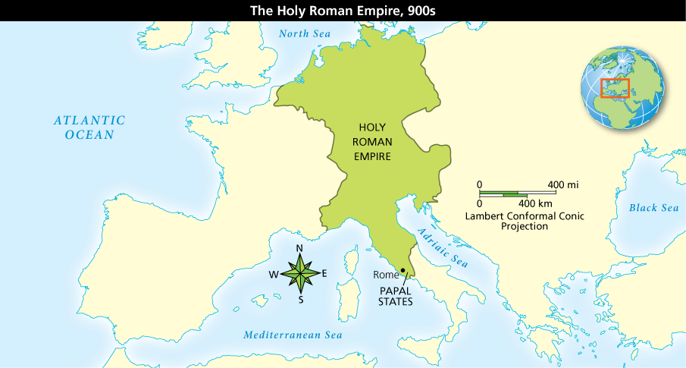
The Holy Roman Empire
The Holy Roman Empire was a vast kingdom that bordered several important bodies of water. This aided in trade as well as defense.Analyze Maps Locate: (a) the North Sea, (b) the Adriatic Sea, (c) the Mediterranean Sea

Slide 18
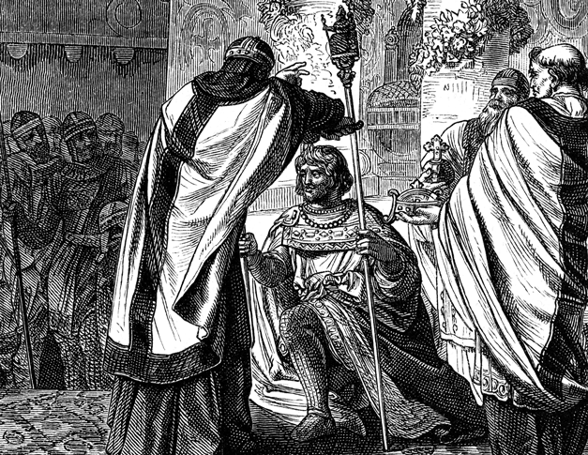
The Holy Roman Empire
Otto I is crowned emperor over a vast area of Europe that will later be known as the Holy Roman Empire.

Slide 19
A Pope and an Emperor Feud
Gregory Undertakes Reforms
Going to ban “lay investiture” meaning that only the Pope can appoint bishops, not secular leaders
Lay investiture means the appointing of a bishop by someone who is not of the clergy
The Emperor Responds
Henry IV is angry because bishops rule their lands like royal fiefs. B/c of that he is their overlord and wants to give them symbols of office
German nobles are going to support the Pope and revolt and Gregory is going to excommunicate Henry
Henry is forced to make peace

Slide 20
A Pope and an Emperor Feud
Henry Repents
Henry is going to go to the Pope and ‘repent’. The Pope knows that he is repenting just to save his throne. The Pope will still forgive him and lift the excommunication
Henry will return home and subdue the rebellious nobles
Later on Henry will lead an army into Rome and exile the Pope
The Concordat of Worms
A treaty that declares that the Church has the sole authority to elect and invest bishops with spiritual authority.
The emperor will still invest them fiefs

Slide 21
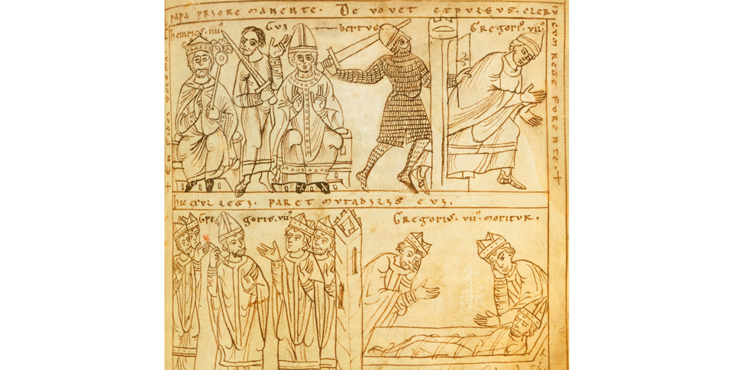
A Pope and an Emperor Feud
A medieval drawing shows Henry driving Gregory from Rome (top). Other scenes include Gregory excommunicating Henry (bottom left) and Gregory on his deathbed (bottom right).

Slide 22
The Battle for Italy
German Emperors In Italy
Frederick I is going to try and control the wealthy northern cities of Italy. Those cities are going to resist and join with the Pope to create the Lombard League
They are going to defeat Frederick’s armies
Frederick is going to get his son Henry to marry Constance, the heir to Sicily and southern Italy
Frederick II
Grandson of Frederick I
Instead of being in Germany being Holy Roman Emperor he is going to stay in Italy, clash with Popes, and try unsuccessfully to control wealthy northern Italian cities like grandpa

Slide 23
The Battle for Italy
Effects of the Struggle
Because Frederick II is in Italy German nobles are going to be more independent. They are going to be a patchwork of feudal states
Sicily and southern Italy are going to become ruins because the Pope is going to ask the French to fight Frederick’s heirs and later on the French and the Spanish are going to fight for possession of the territory.

Slide 24
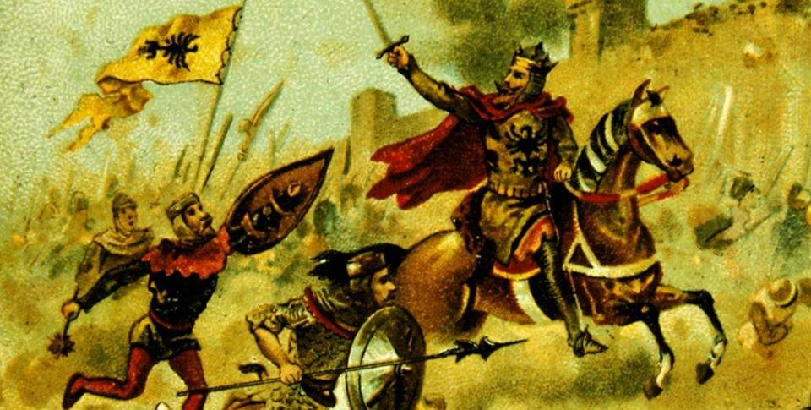
The Battle for Italy
Frederick Barbarossa, or Frederick Red-Beard, leads soldiers in battle against the Seljuk Turks.

Slide 25
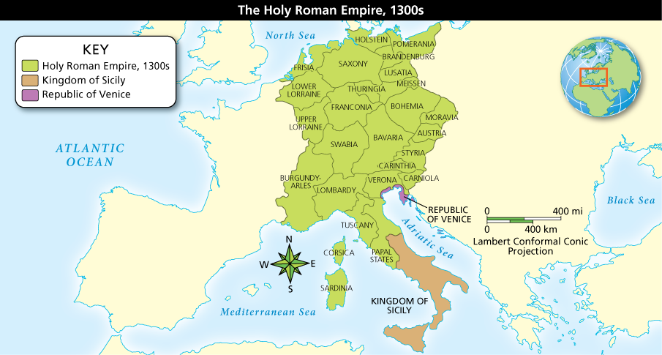
The Battle for Italy
Frederick II spent much of his rule fighting for territory around the Kingdom of Sicily.Analyze Maps Why do you think that the barons and nobility of areas such as Saxony and Bavaria were successful in breaking into independent states?

Slide 26
Church Power Reaches Its Peak
Popes Assert Their Power
Pope Innocent III (elected in 1198) claims “The Pope stands between God and man, lower than God but higher than man, who judges all and is judged by no one”
He excommunicates King John of England
He excommunicates King Phillip II for trying to annul his marriage
With Phillip II help he is going to order the deaths of Albigensians in Southern France for heresy.
Extend the Papal States, reformed the Church courts, and change the way Church officials are elected.
Papal Power Begins to Decline
When Phillip IV engineers the election of a French Pope after trying to capture the previous one, this will lead to the decline of the office.
There will be seven French Popes

Slide 27
Church Power Reaches Its Peak
Papal Power Begins to Decline
Eventually the 7th French Pope is going to return to Rome but he dies shortly after
The cardinals in Rome are going to elect an Italian Pope but the French cardinals are going to elect their own pope. This will start another line of French Popes.
This will lead to a schism in the Church as no one can agree who is in power.
Eventually the Roman Pope is going to be the one everyone agrees to follow but the damage is done. The common folk and nobles are going to lose a lot of respect for the clergy

Slide 28
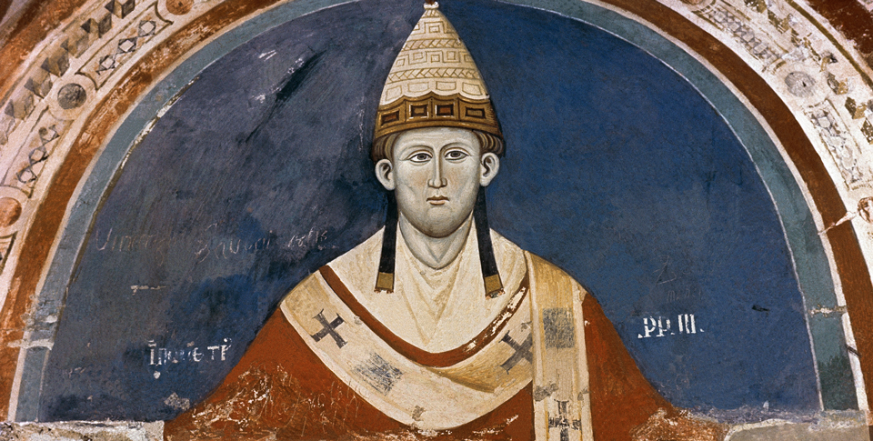
Church Power Reaches Its Peak
Under Pope Innocent III, the Church reached a level of power it would never again attain. Innocent saw himself as second only to God, but above all other men.

